Slide 1



High Level Feasibility Report for Co Op Shop for local produce on the Dingle Peninsula
November2024

Slide 2

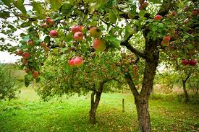
Consultant Brief – JB&A Food & Retail Business Advisors
Stakeholder meeting with Margadh Chomharchumann Thairgeoiri Bia Chorca Dhuibhne
Research local food organisations in Ireland and Internationally
Research and identify optimum legal structure for enterprise (Co-Op/Social Enterprise etc)
Conduct market research & identify optimum shop location
Identify infrastructure requirements including set up Capex,
Develop operating model and financial projections including revenue and ongoing operations costs etc
Develop marketing plan
Review regulatory compliance requirements
Identify other complementary services that could be provided by such an enterprise
Conduct risk analysis
Produce feasibility report

Slide 3
Research Irish Food Organisations
THE COTTAGE MARKET
Fiorbhia Farm
Dublin Food Coop
https://cottagemarketcavan.ie
Set up as a Social Enterprise
Are experts at tapping into local and national funding schemes
Are strategic about their journey and have a vision statement and strategy actin plan
Excellent ecommerce site
Good use of social media
https://www.fiorbhiafarm.ie/
Set up as Private Enterprise
Regenerative farm with direct consumer sales
Significant messaging around sustainability
Many references to nutrient dense products
Use of customer newsletter
Over 7000 followers on Instagram with very regular posting
https://dublinfood.coop/
Set up as Co-op
Consumer direct organic, vegetarian and wholefoods retailer
A “readymade customer” exists in the Coop membership model
Almost 10,000 followers on Instagram with videos having a minimum views of 1,000 followers and sometimes up to 3,200, and 12,200 Facebook followers
Ongoing calendar of talks and events

Slide 4
Research Irish Food Organisations
THE LITTLE MILK COMPANY
Brookfield Farm
Larder 360
https://www.thelittlemilkcompany.ie/
Set up as a Co-op
Strong story telling about each of the farm families
Repeat mentions of sustainability and eco credentials
Have a professional sales team in place
Have managed to scale up to become a very large operator
https://www.brookfield.farm/
Set up as Private Enterprise
Excellent marketing and communications
Revenue being generated by multiple revenue streams from the farm
Pioneering model of getting the customer to “forward pay” for their product
Strong educational aspect to the model
Links to nature and biodiversity are part of the core messaging
Set up as a Co-op
Objective was to make small food production more readily available
Developed to operate as a shared economy, pooling the resources of many
Was an online marketplace creating a one stop shop for all local farm produce
The model failed due to its inability to generate enough revenue in the local region

Slide 5
Research International Food Organisations
The Food Coop (USA)
Kent food Hubs (UK)
North Arm Farms (Australia)
https://www.foodcoop.coop/
Set up as a Co-Op
7,000 Co-Op members
Calendar of regular events
Strong community focus
A “readymade customer” exists in the Coop membership model.
Little evidence of Ecommerce being used.
Apparent limited use of Ecommerce channel
https://www.kentfoodhubs.co.uk/
Set up as Co-Op
Anchored on a veg box scheme.
Delivered to customer home and collection points.
Strong focus on getting customers to sign up for a newsletter.
Talk of shorter food supply chains and “knowing where your food comes from”.
https://openfoodnetwork.org.au/north-arm-farms/shop#/about_panel
Set up as a collective (Joint Venture)
Umbrella brand.
Strong story telling of individual farmers and producers.
Using Open Food Network existing technology.
Good sustainability benefits called out to consumer

Slide 6

Legal Structure Options
The following legal structures were reviewed as possible models for a local food enterprise collective:
DAC
CLG
A DAC allows specific activities or objectives to be defined in its constitution, ensuring the business operates within its intended purpose while maintaining legal accountability.
Shareholders (farmers) are only liable for the company's debts up to the amount they invested, protecting personal assets.
Operating as a DAC can enhance the enterprise's credibility with suppliers, customers, and potential investors, as it demonstrates a formal and structured approach.
Unlike cooperatives, a DAC can raise funds through shareholders without requiring equal ownership or voting rights, making it attractive for investors while retaining managerial control.
A DAC can still access various grants and supports, particularly if it aligns with local or regional development goals, while also benefiting from corporate tax incentives.
A CLG is ideal for enterprises focused on community benefit, as profits are reinvested into the business or its mission rather than distributed to shareholders.
Members’ (farmers) liability is limited to a nominal amount (e.g., €1), offering financial protection for those involved.
Many public and private funding bodies prefer or require a non-profit structure like a CLG to qualify for grants, particularly in community, food, or rural development sectors.
As a non-profit structure, a CLG promotes transparency and trust among local stakeholders, enhancing the enterprise’s reputation as a community-focused initiative.
Unlike other company types, a CLG does not require shareholders, making it simpler to maintain a structure focused purely on its mission rather than profit distribution.

Slide 7
Legal Structure Options
LTD Company
Co-Op
Shareholders (Farmers/Fishers/Growers) are only liable for the company's debts up to the amount they have invested, protecting personal assets from business risks.
An LTD structure enhances trust with customers, suppliers, and investors, as it conveys a formal and well-regulated business approach.
LTDs can issue shares to attract external investors, making it easier to raise capital for expansion while maintaining control over operations.
LTDs benefit from lower corporate tax rates compared to personal income tax, as well as opportunities to claim business-related expenses.
The company’s operations are not tied to the life of its owners, ensuring continuity even if ownership changes.
An LTD allows profits to be distributed to shareholders or reinvested into the business, providing operational and financial flexibility.
Cooperatives are owned and controlled by their members (Farmers/Fishers/Growers), fostering a sense of shared responsibility and loyalty among stakeholders, including farmers, producers, and consumers.
Cooperatives are often eligible for grants, tax incentives, and support from organisations that promote sustainable and community-oriented businesses, like LEADER in Ireland.
Each member typically has an equal vote in decisions, ensuring that the enterprise reflects the interests and priorities of the community it serves.
Members pool resources such as equipment, infrastructure, and marketing, reducing costs and spreading financial risks across the group.
Unlike traditional profit-driven businesses, cooperatives often prioritise sustainable practices, fair pricing, and community well-being over short-term profits

Slide 8
Legal Structure options
Social enterprise
Retail Collaboration
Producers Organisation (PO)
A social enterprise is not in of itself a legal entity.
A social enterprise prioritises a social or environmental mission, such as supporting local farmers, reducing food waste, or improving food accessibility, aligning well with community values.
Social enterprises are eligible for specialised grants, loans, and support from organisations that promote social impact, including government programs and philanthropic initiatives.
Operating as a social enterprise enhances credibility, as it demonstrates a commitment to benefiting the community rather than focusing solely on profit-making.
Unlike charities, social enterprises can generate income through trading activities while reinvesting profits into their mission, ensuring long-term viability.
Social enterprises often attract customers and partners who share similar values, fostering strong community connections and loyalty.
Social enterprises can adopt various legal forms (e.g., CLG, DAC, cooperative) to match their specific needs while maintaining their social objectives.
This model might entail one or more retailers voluntarily collaborating with farmers/fishers/ growers
By pooling products under one roof or brand, participants (famers/Fishers/Growers) can attract the retailers customer base, offering a diverse range of local goods that appeal to more consumers creating a win win.
A Retailer collaboration would support other local food businesses by creating a centralised retail hub for local products, fostering economic resilience and community growth.
Collaborative efforts enable a unified marketing approach, increasing brand visibility and recognition for all members involved.
Retail collaborations, especially in the food sector, are often eligible for funding and support through government or regional development programs, such as LEADER or DAFM in Ireland. This would require the food suppliers to form an entity to apply for funding.
Retail collaborations can adopt a cooperative, partnership, or other legal entity that suits the needs of the participating members, allowing tailored governance and profit-sharing models
POs enable producers to negotiate better prices and terms with buyers, suppliers, and distributors by pooling their resources and products.
Recognised POs are eligible for specific grants and subsidies, especially in the food and agricultural sectors, under schemes like the EU Common Agricultural Policy (CAP).
Farmers/Fishers/Growers would share costs for marketing, distribution, processing, and other activities, reducing individual expenses and improving operational efficiency.
POs help stabilise prices and manage supply chains effectively by coordinating production and distribution among members.
By acting as a unified entity, POs can compete more effectively in larger markets, leveraging scale to meet demand and secure contracts.
POs often promote sustainable farming practices and local food systems, benefiting the environment and community.

Slide 9

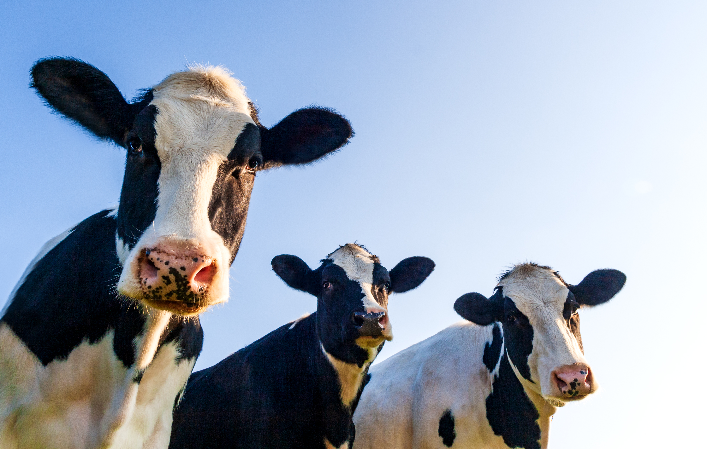
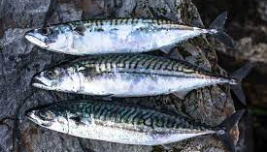
Market Research
The aim of the research:
To engage with the consumer and businesses on the Dingle Peninsula Area to establish if there is a market for local produce
Understand consumer preference to access this produce
Establish if there is a premium for the producer in a shorter farm to fork supply chain

Slide 10

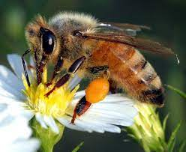
The Research
The initial research was done through an anonymous consumer survey (62 respondents) and a survey of local supermarket businesses on the Dingle Peninsula.
Follow up research was conducted by way of a two-cycle lamb trail between a sheep farmer and a supermarket on the Dingle Peninsula. The trial also involved a local farmer to source the lambs, an abattoir, suitable transport to and from the abattoir and promotion of the trial.?
All elements of research outlined above have served to inform next steps for the farmers in getting their product to market in a way that meets consumer expectations and demands.

Slide 11
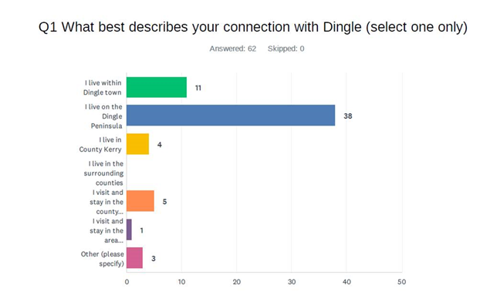
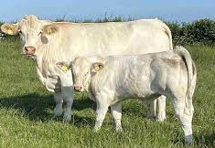
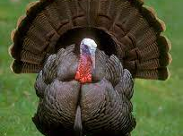
General Findings of the Survey Research

Slide 12
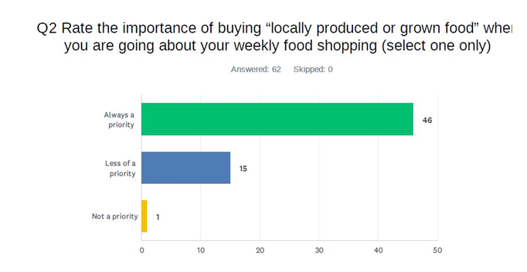
General Findings of the Survey Research

Slide 13
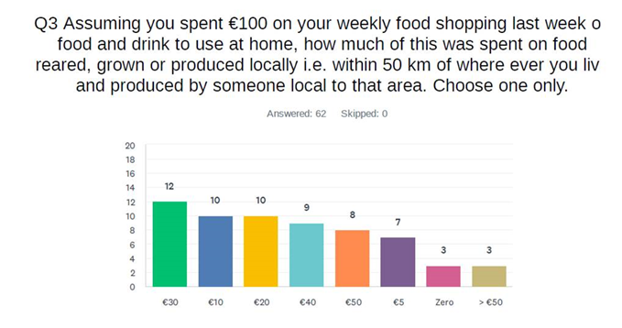
What do you spend on local food?

Slide 14
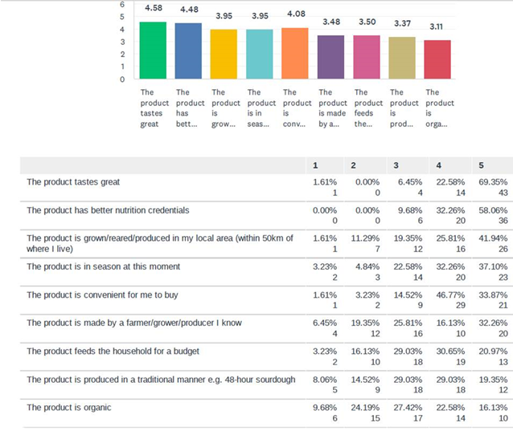
What's important in choosing local food?

Slide 15
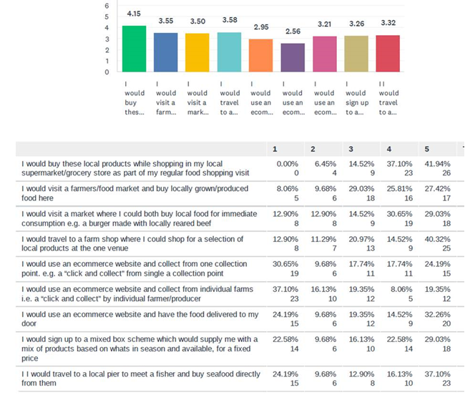
Where would you buy local food?

Slide 16
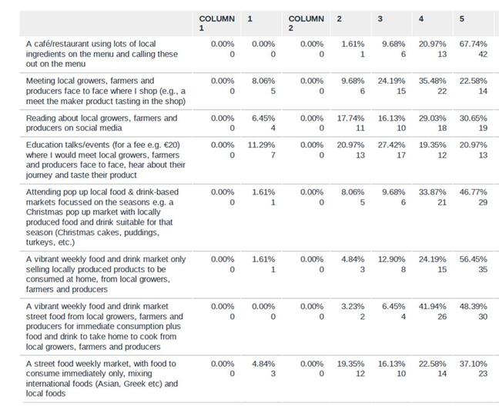
What is of most interest when it comes to buying local food?

Slide 17
General Findings of the initial Survey Research
Strong Interest in local food (74%)
Access to local food had to be convenient to make it attractive to consumers
47% prepared to spend 30%+ of their weekly food budget on local food
Taste and nutrition were the most important factors when choosing local food
Seasonal food markets are of interest as are regular weekly farmers markets
Travelling to the pier was popular to buy local fish
Restaurants with local food is a key area of interest for consumers

Slide 18
Consumer Feedback on Co-Op Shop
Consumers favoured as their number 1 choice, the ability to buy local food while doing their regular supermarket shopping because of the convivence
The concept of travelling to a dedicated local food shop did not have the same appeal
Furthermore, the complexities identified in running a dedicated local food shop and the need for famers and other stakeholders to have a heavy involvement in this, led to a conclusion that the model of a dedicated local food shop was premature (but may have a role later in the cycle)
The research identified greater consumer interest in areas like selling local lamb via existing retail shops, shopping at seasonal food and drink markets and travelling to a local pier to buy freshy caught seafood and shellfish.
These findings combined with the ‘newness’ of sales and marketing collaborations models to Dingle farmers/fisher/growers led the project to pilot test models in these areas, as more high potential developments

Slide 19
Local Food Co-Op Shop Demo Weekly Financial Mode
Item | Euro
Weekly Sales (Incl VAT) | €3,000
Weekly Sales (ex VAT) | €2,810
Gross Margin (@35%) | €983
Rent (€25,000 per annum) | €480
Wages (Volunteers + 1 paid staff) | €630
Paper and Bags | €150
Light, Heat and Power | €50
Overheads / Admin | €150
Weekly Loss | -€477
Sales of €3,000 per week are based on other local food retail experiences
The model above demonstrates that for the Co-Op Shop to be successful sales would need to be closer to €4,500 per week to break even, which are unlikely for a cold start project and could take up to 3 years to reach this level
The research concludes that other models (eg. Selling local produce via existing shops) which consumers are more receptive to, should be piloted as phase 1, and when Dingle short food supply chains are better understood by consumers the local Co-Op Shop could be revisited

Slide 20
Farming Earnings Comparison Supermarket v Direct Selling
Model | Sales (€) to Consumer | Distribution Charge (€) | Time on Stall | Supermarket Margin (€) | Market Stall Rental (€) | Farmer's Earnings (€)
Direct to Customer | 1000 | 100.0 | 4 Hrs €64 | N/A | 30 | 806.0
Via Supermarket | 1000 | 100.0 | N/A | 300.0 | N/A | 600.0
Conclusions
While the model suggests the farmer earns more by selling directly at a market to consumer there are other considerations
There is a higher cost of gaining customer loyalty when direct selling, and a large workload the famer has to undertake both in terms of marketing and supply chain
Potential higher price per Kg paid by the consumer via direct selling could potentially enhance this model
It could be challenging to the famer to achieve sales of €1000 in one day at a market

Slide 21
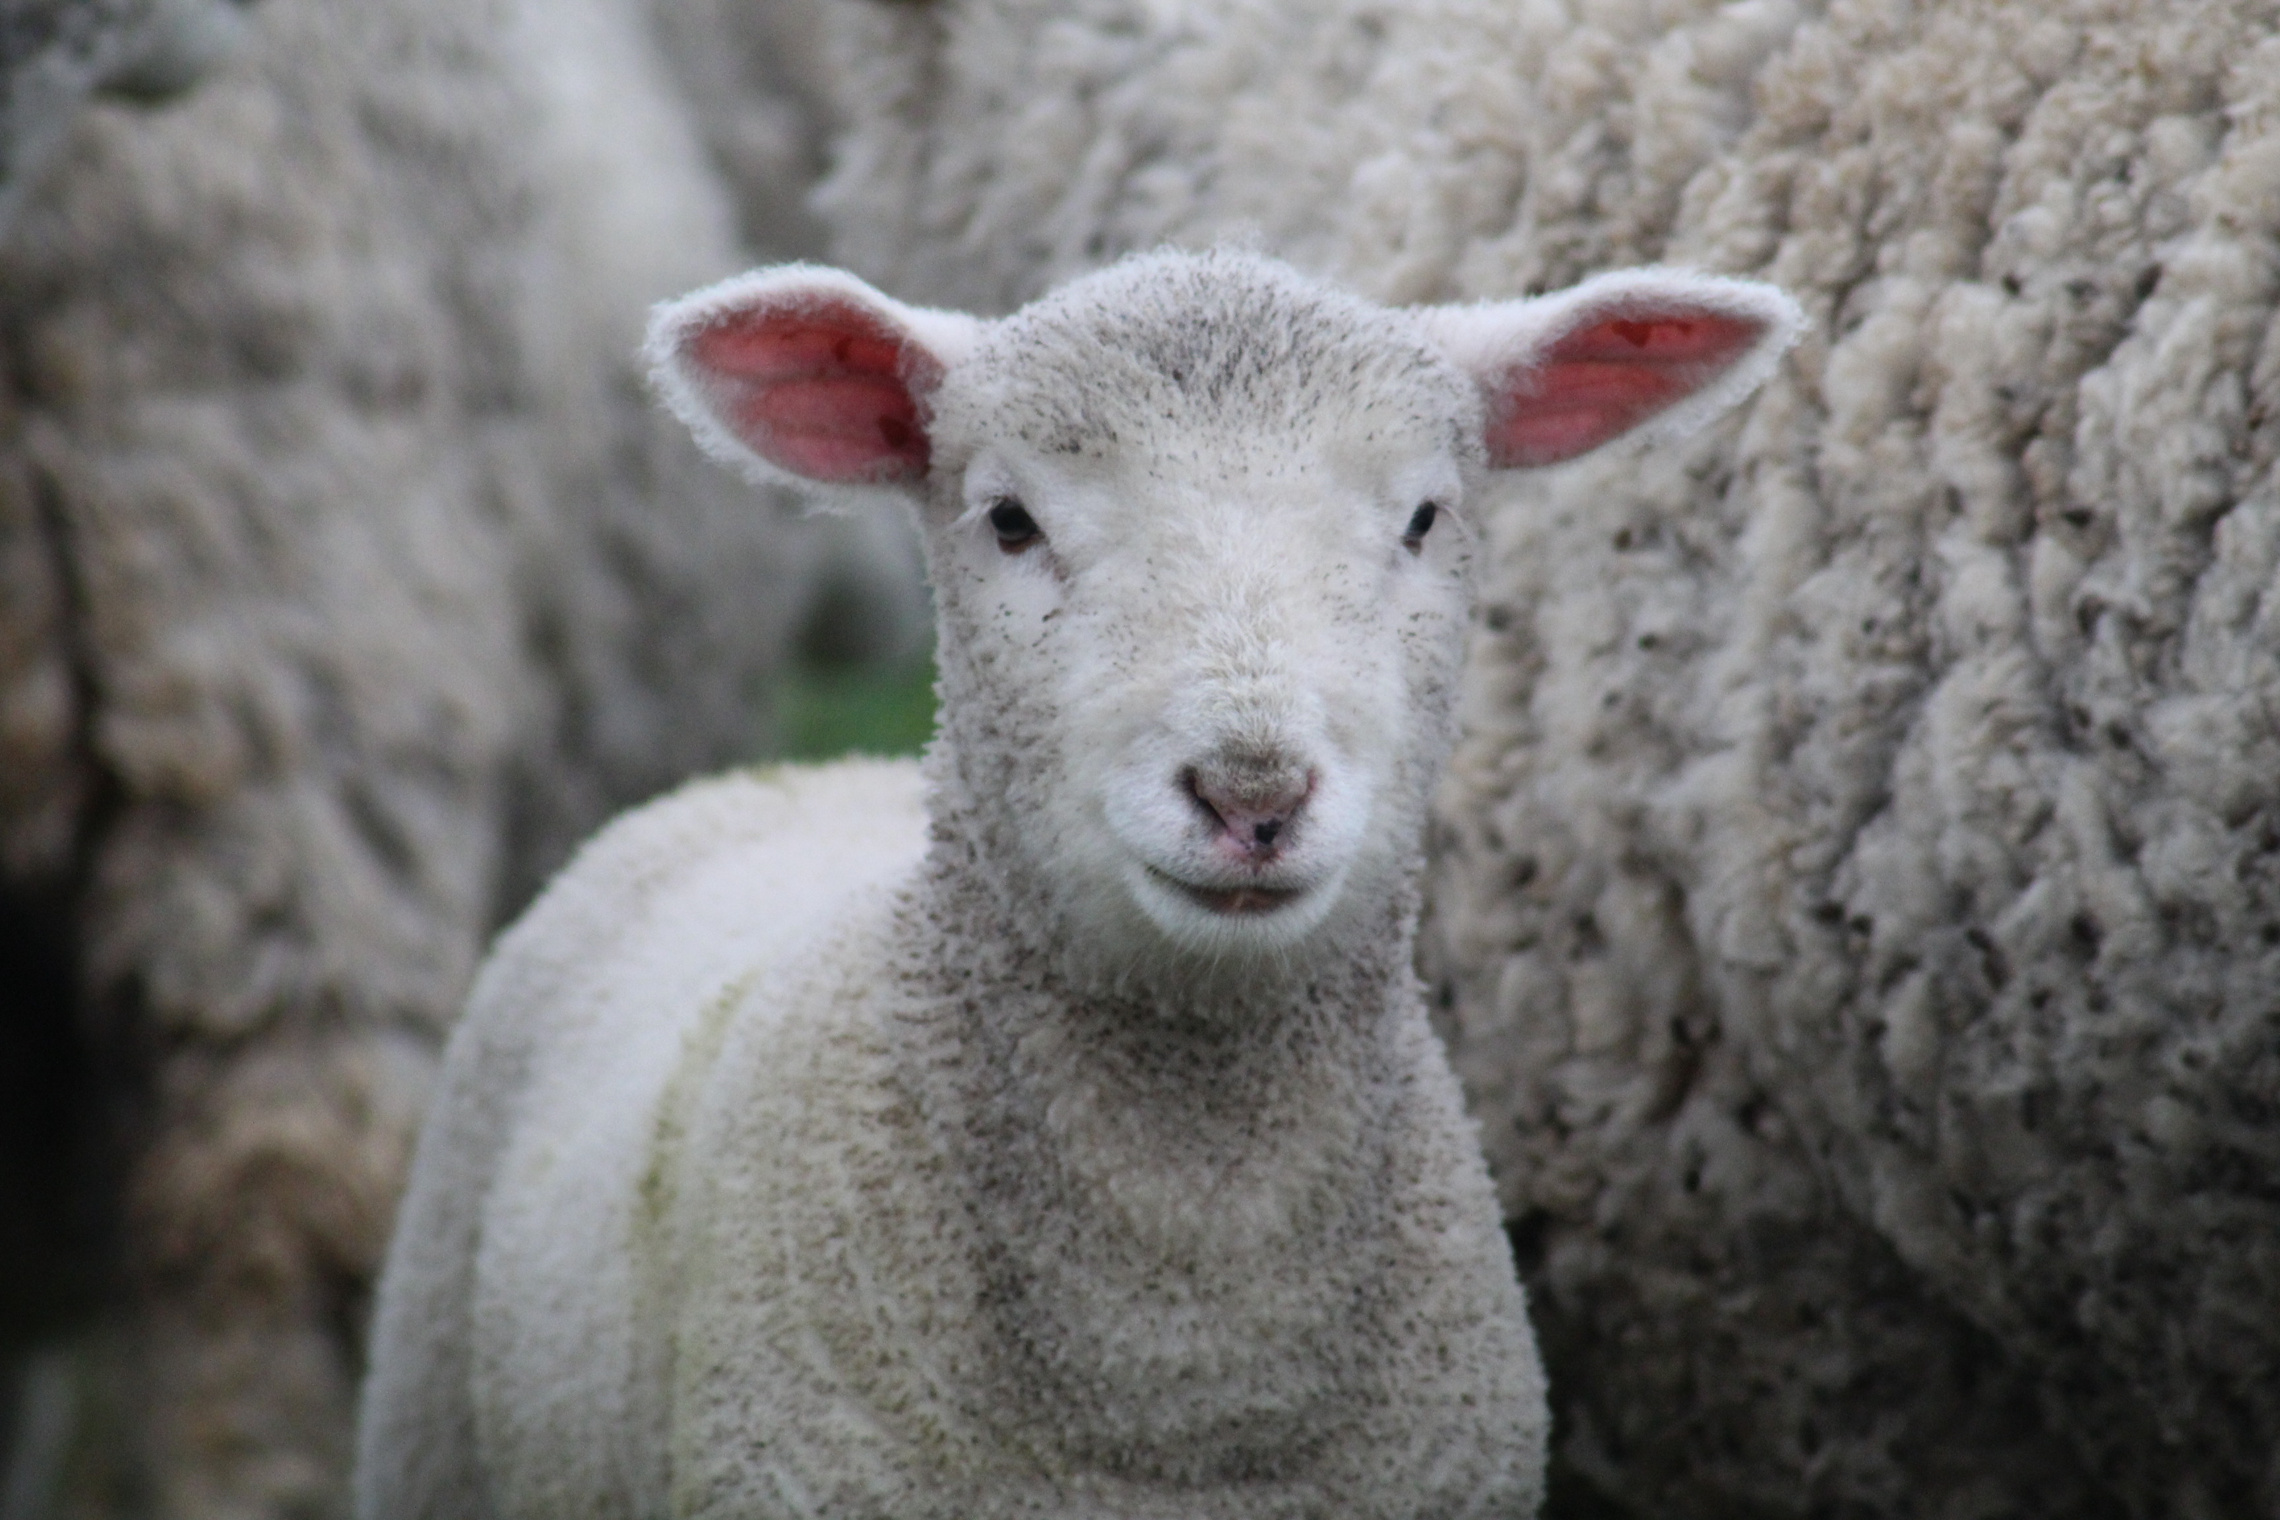
Lamb Trial September – October 2024 Marketed locally through social media channels

Slide 22

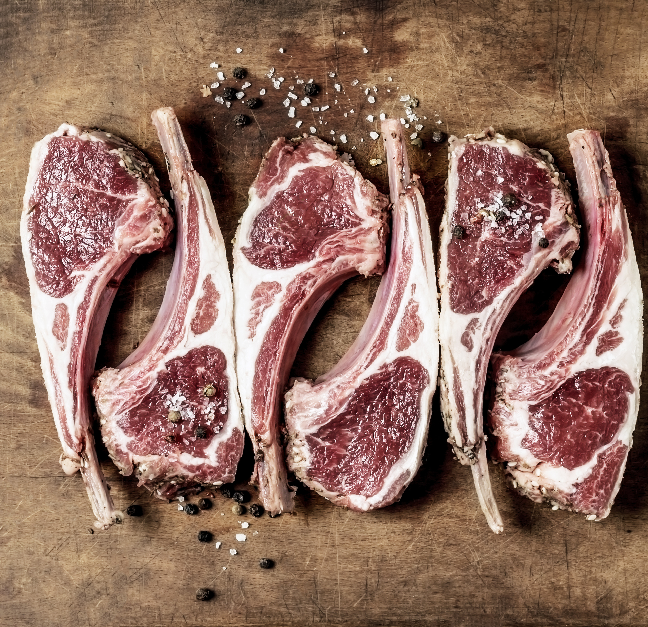
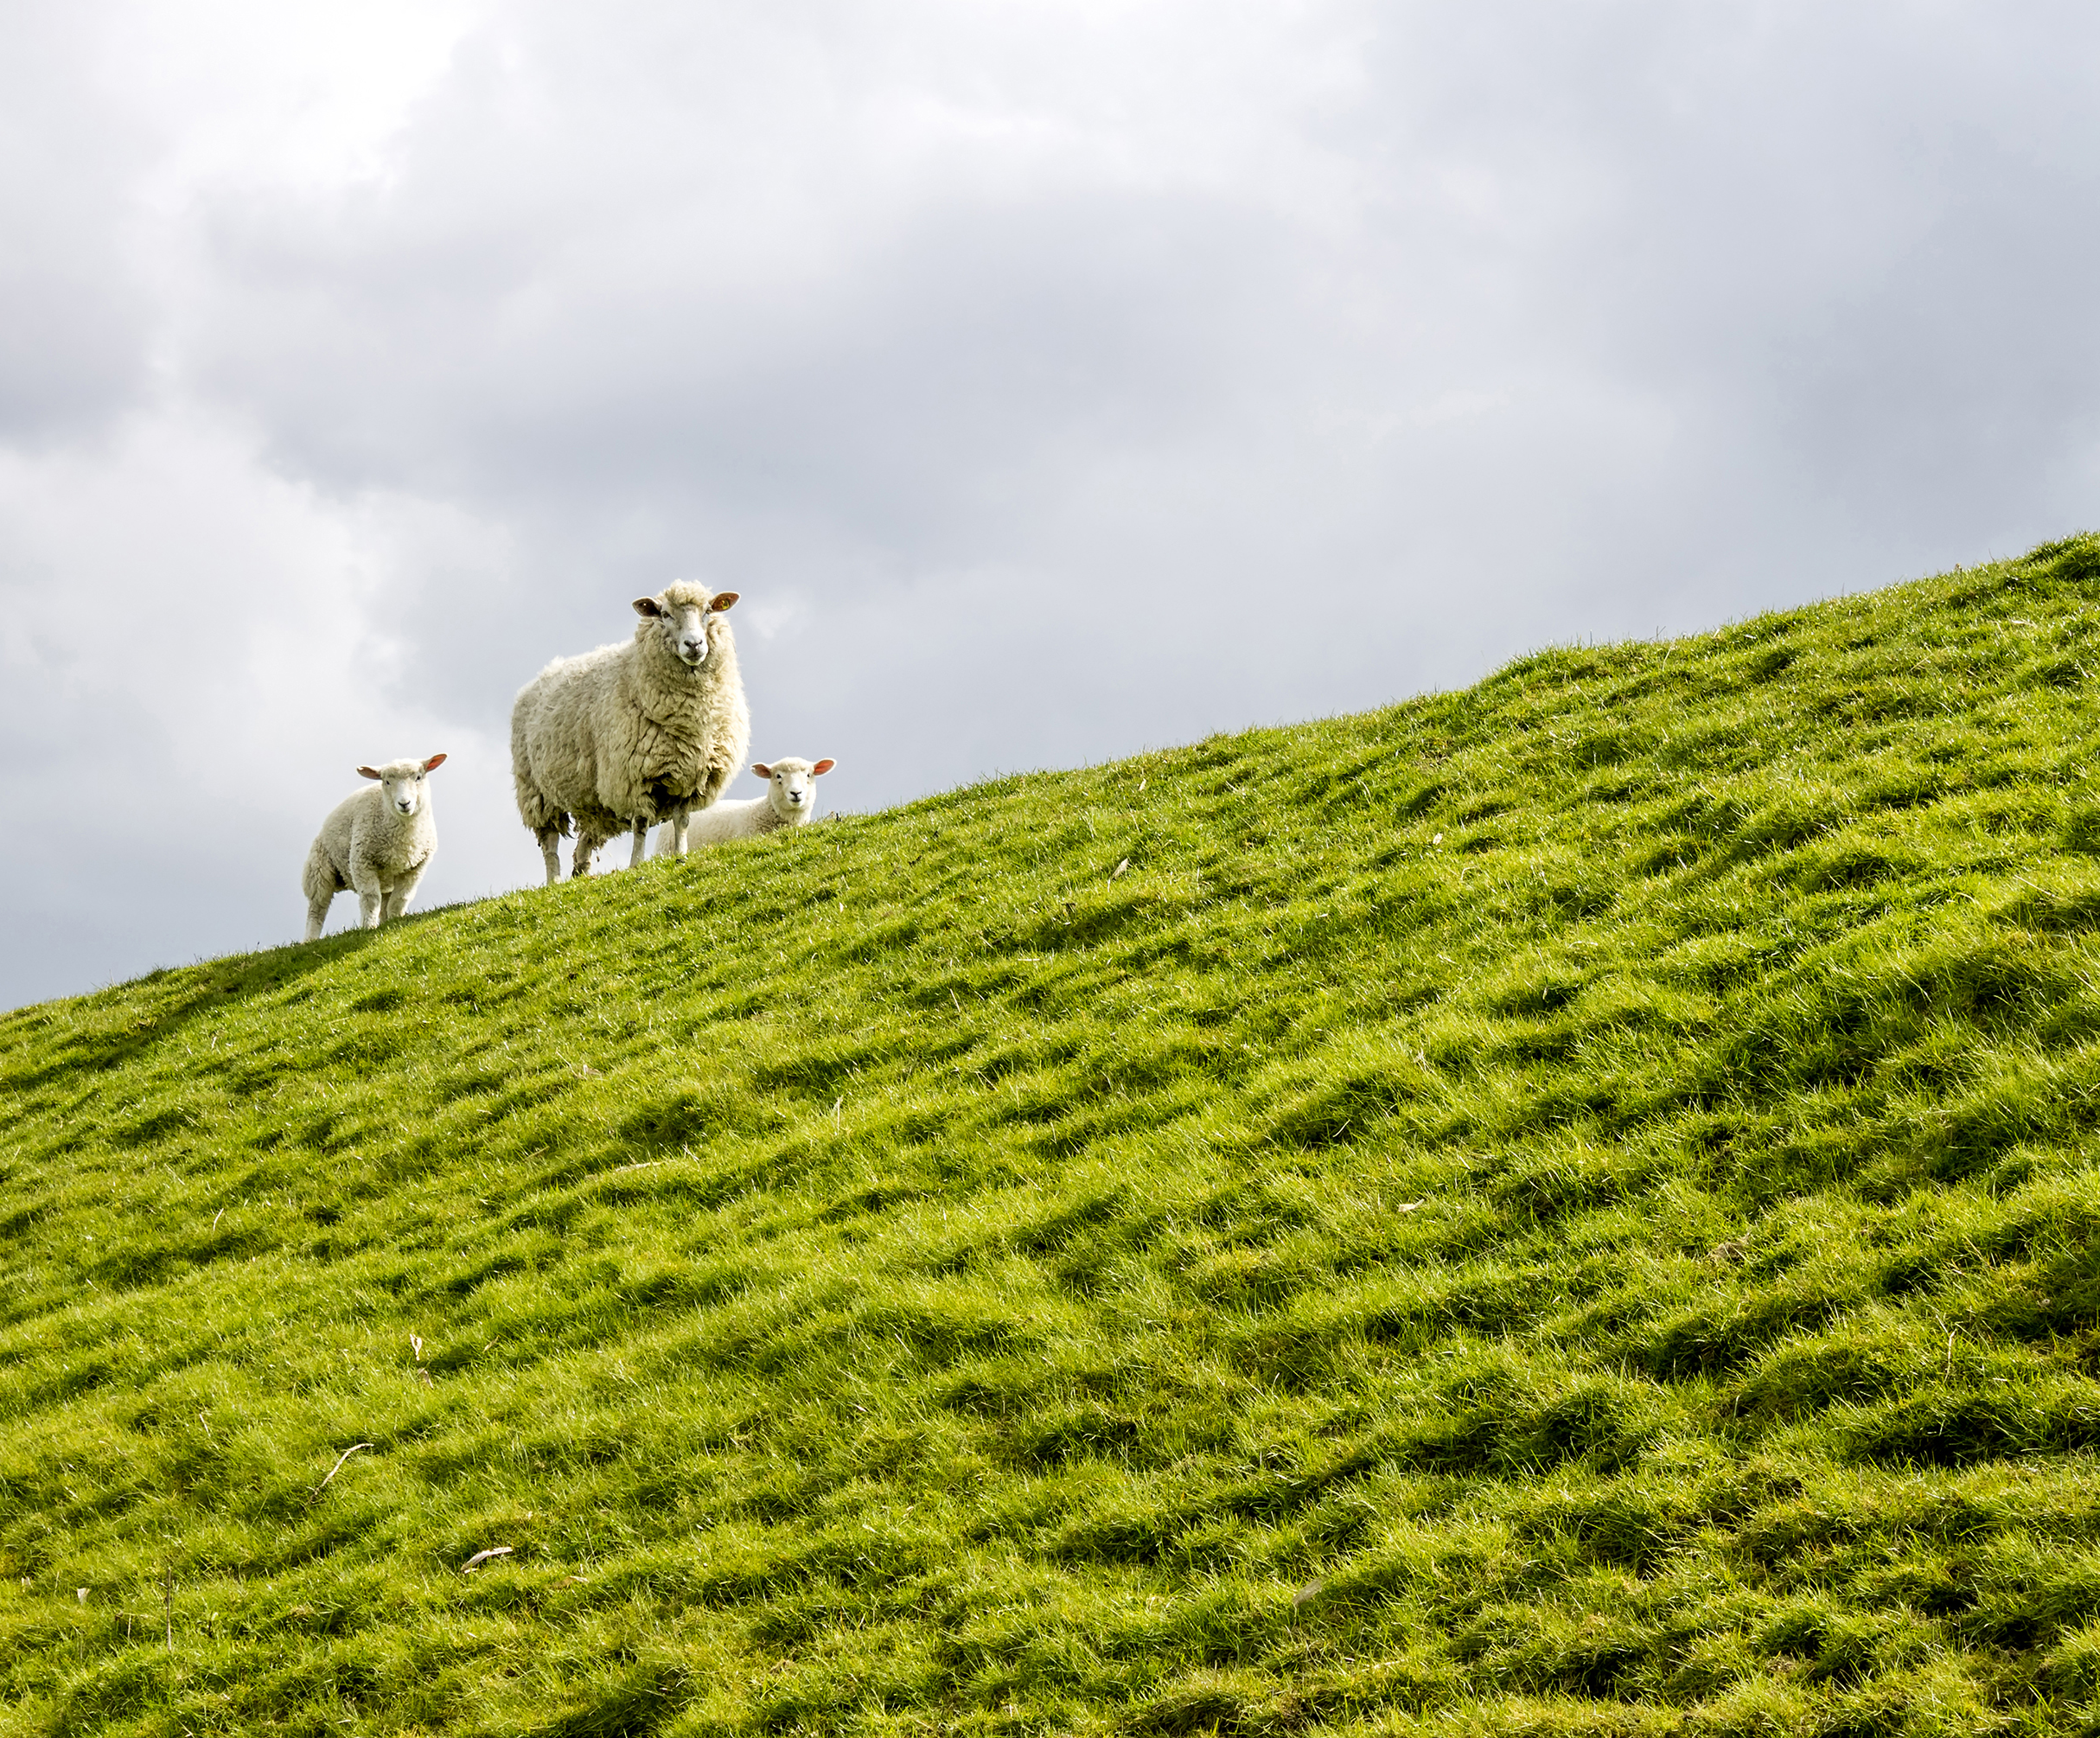
High level feedback from lamb trial
Confirmed market for local lamb and great feedback on quality/taste
Supply chain risk/liability a concern
Weight of responsibility & profile as sole supplier of lamb
Transport to/from abattoir expensive
Quality controller required to select animals
22kg+ carcass weight is the optimum dead weight for retail
Fixed price for lamb killing out at different weights an issue (1st lot avg 22kg, 2nd lot 19.5kg)
Potential premium beyond 22kg for farmer v what they get at the factory
Customer may pay 5-10+% premium for local lamb
Ordering/processing/slaughter/transport coordination process was clunky
Supply and seasonality a concern
Offal an opportunity to maximise retail return
Different breeds present differently in shop : Scotch v Texel Cross
Limited supply due to bi-monthly kill at Abattoir
Economies of scale required to make local lamb financially viable

Slide 23
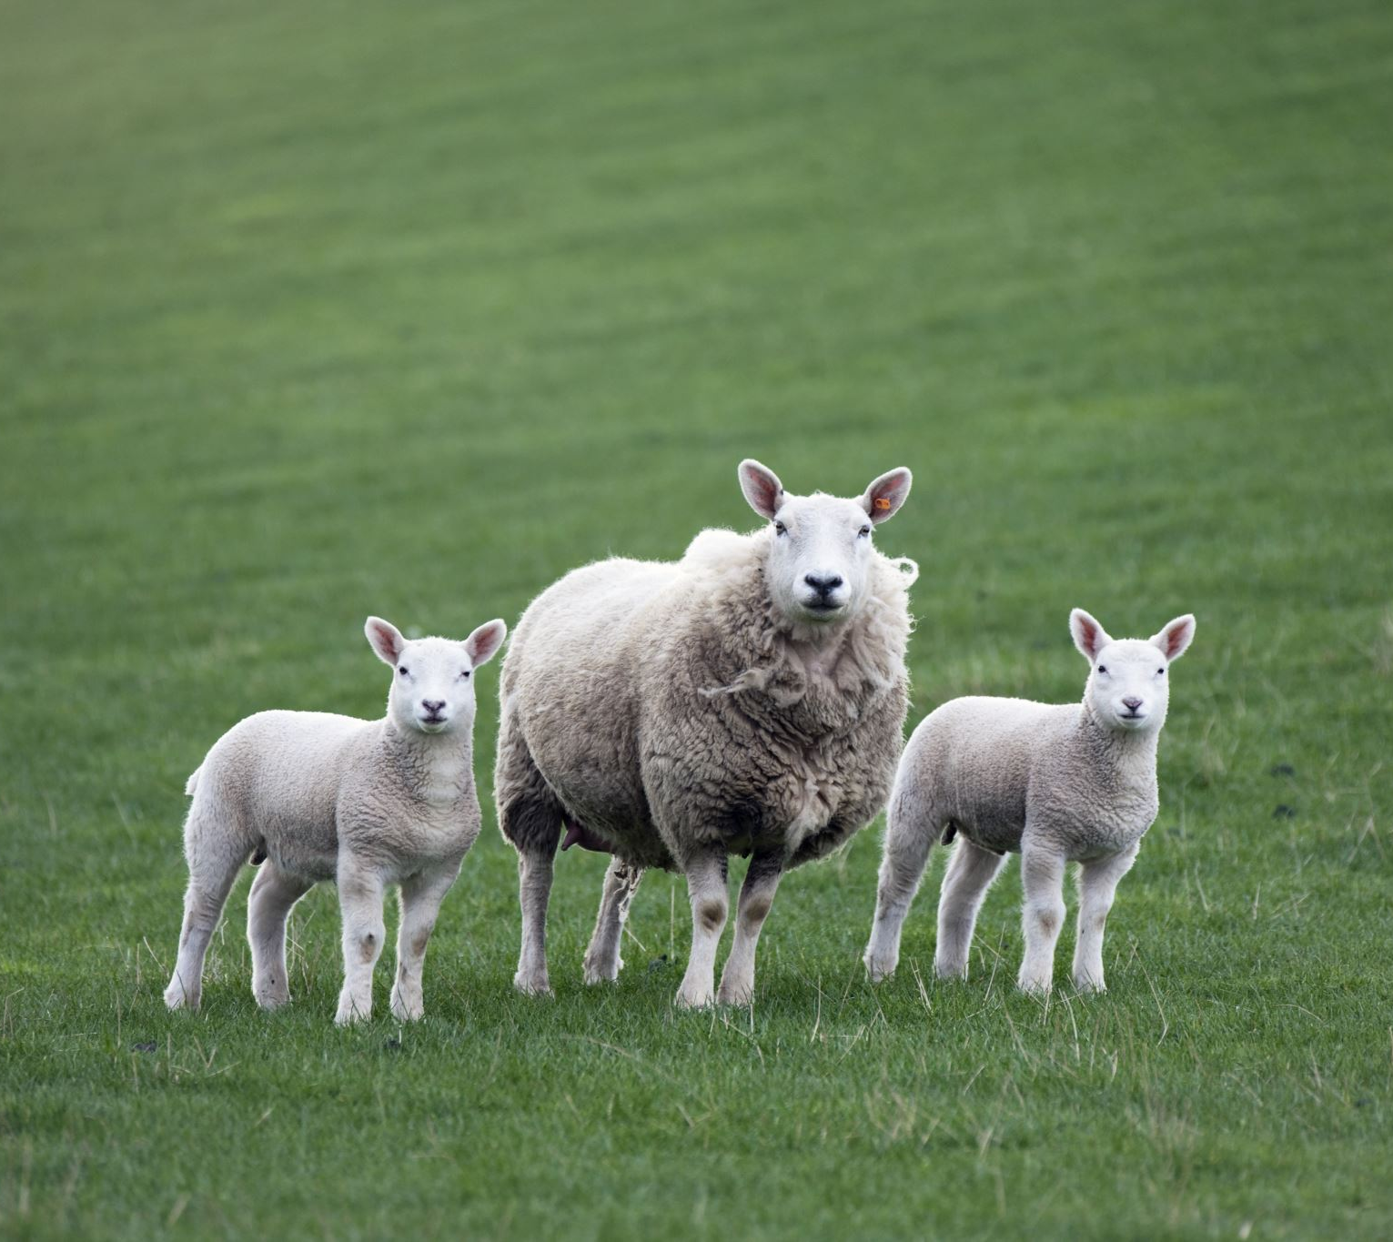
The sums and
the importance of economies of scale
Lamb sold in SPAR at normal market rate per KG for different cuts

Slide 24

Compliance Requirements & Risk Analysis of Trial
Food Safety Regulation
Transport
Meat Quality
Bi Monthly slaughter

Slide 25
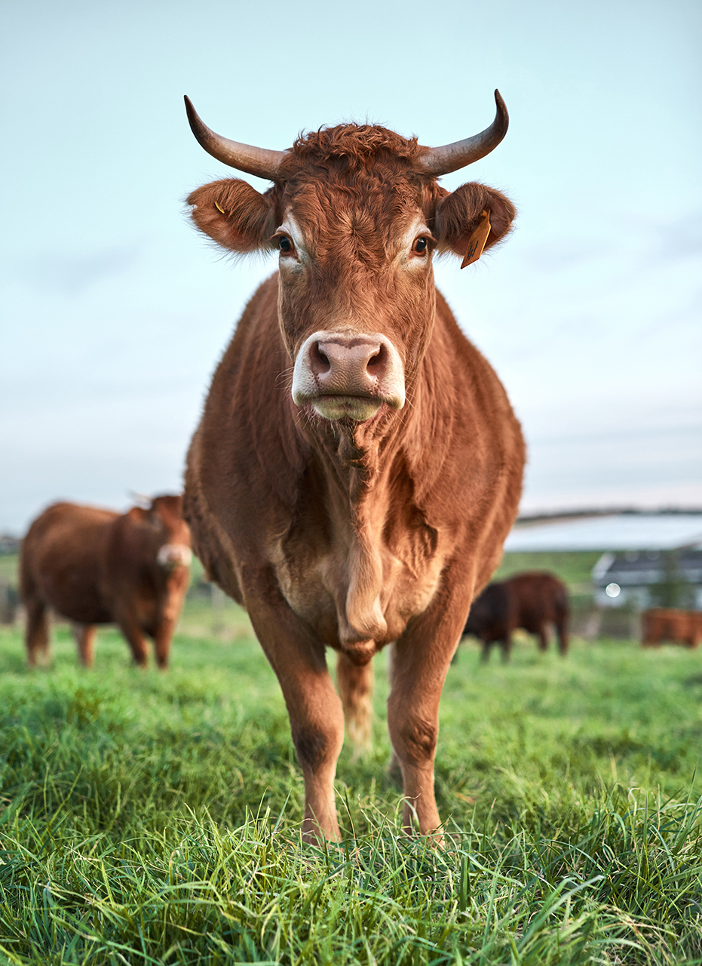
Research Conclusions
A local food Co-Op Shop may have potential in the medium-term future (but only when local food credentials are established in the region)
The research recommends larger scale piloting of short food supply chain projects focused on local fish, lamb and vegetables be undertaken
While the Co-Op model is favoured by stakeholder’s further exploration should be undertaken to focus on other models including the formation of a Limited Company with a local food focus
The formation of a virtual Co-Op should also be explored in conjunction with enablers like the Open Food Network

Slide 26
Next Steps -In depth feasibility and strategic plan for local fish, vegetables and lamb businesses -Review primary producer opportunities for milk -Identify optimum structures for businesses to be successful and a collective support function for these businesses to assist with marketing, sales, compliance etc.

